Slide 1



An Environmental Surveillance Study of Salmonella in a Multi-Species Animal Facility
Steven R. Kitchens
Department of Pathobiology
Zheran (Rachel) Wang
Department of Mathematics and Statistics

Slide 2
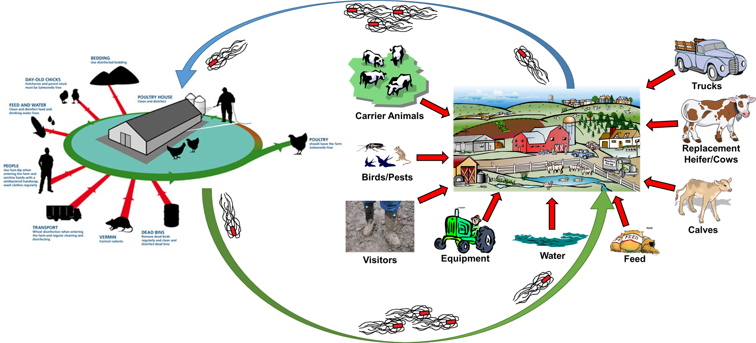
Salmonella Movement Between Animal Facilities
http://www.thepoultrysite.com/articles/contents/11-11-25CIDLines1.jpg

Slide 3

Veterinary Teaching Hospital Outbreaks
Michigan State University – 1996
Purdue University – 1999
University of Pennsylvania – 2003
Cornell University – 2006
Schott, H. C., et al. 2001. An outbreak of salmonellosis among horses at a veterinary teaching hospital. J. Am. Vet. Med. Assoc. 218:1152–1159, 1100.
Cummings KJ, et al, 2014. Salmonella enterica Serovar Oranienburg Outbreak in a Veterinary Medical Teaching Hospital with Evidence of Nosocomial and On-Farm Transmission. Vector-Borne Zoonotic Dis. 14:496–502.
Ward MP, et al. 2005. Investigation and control of an outbreak of salmonellosis caused by multidrug-resistant Salmonella typhimurium in a population of hospitalized horses 107:233–240.
Schaer BLD, et al. 2010. Outbreak of Salmonellosis Caused by Salmonella enterica Serovar Newport MDR-AmpC in a Large Animal Veterinary Teaching Hospital 1138–1146.
Schaer BLD, et al. 2010. Outbreak of Salmonellosis Caused by Salmonella enterica Serovar Newport MDR-AmpC in a Large Animal Veterinary Teaching Hospital 1138–1146.

Slide 4
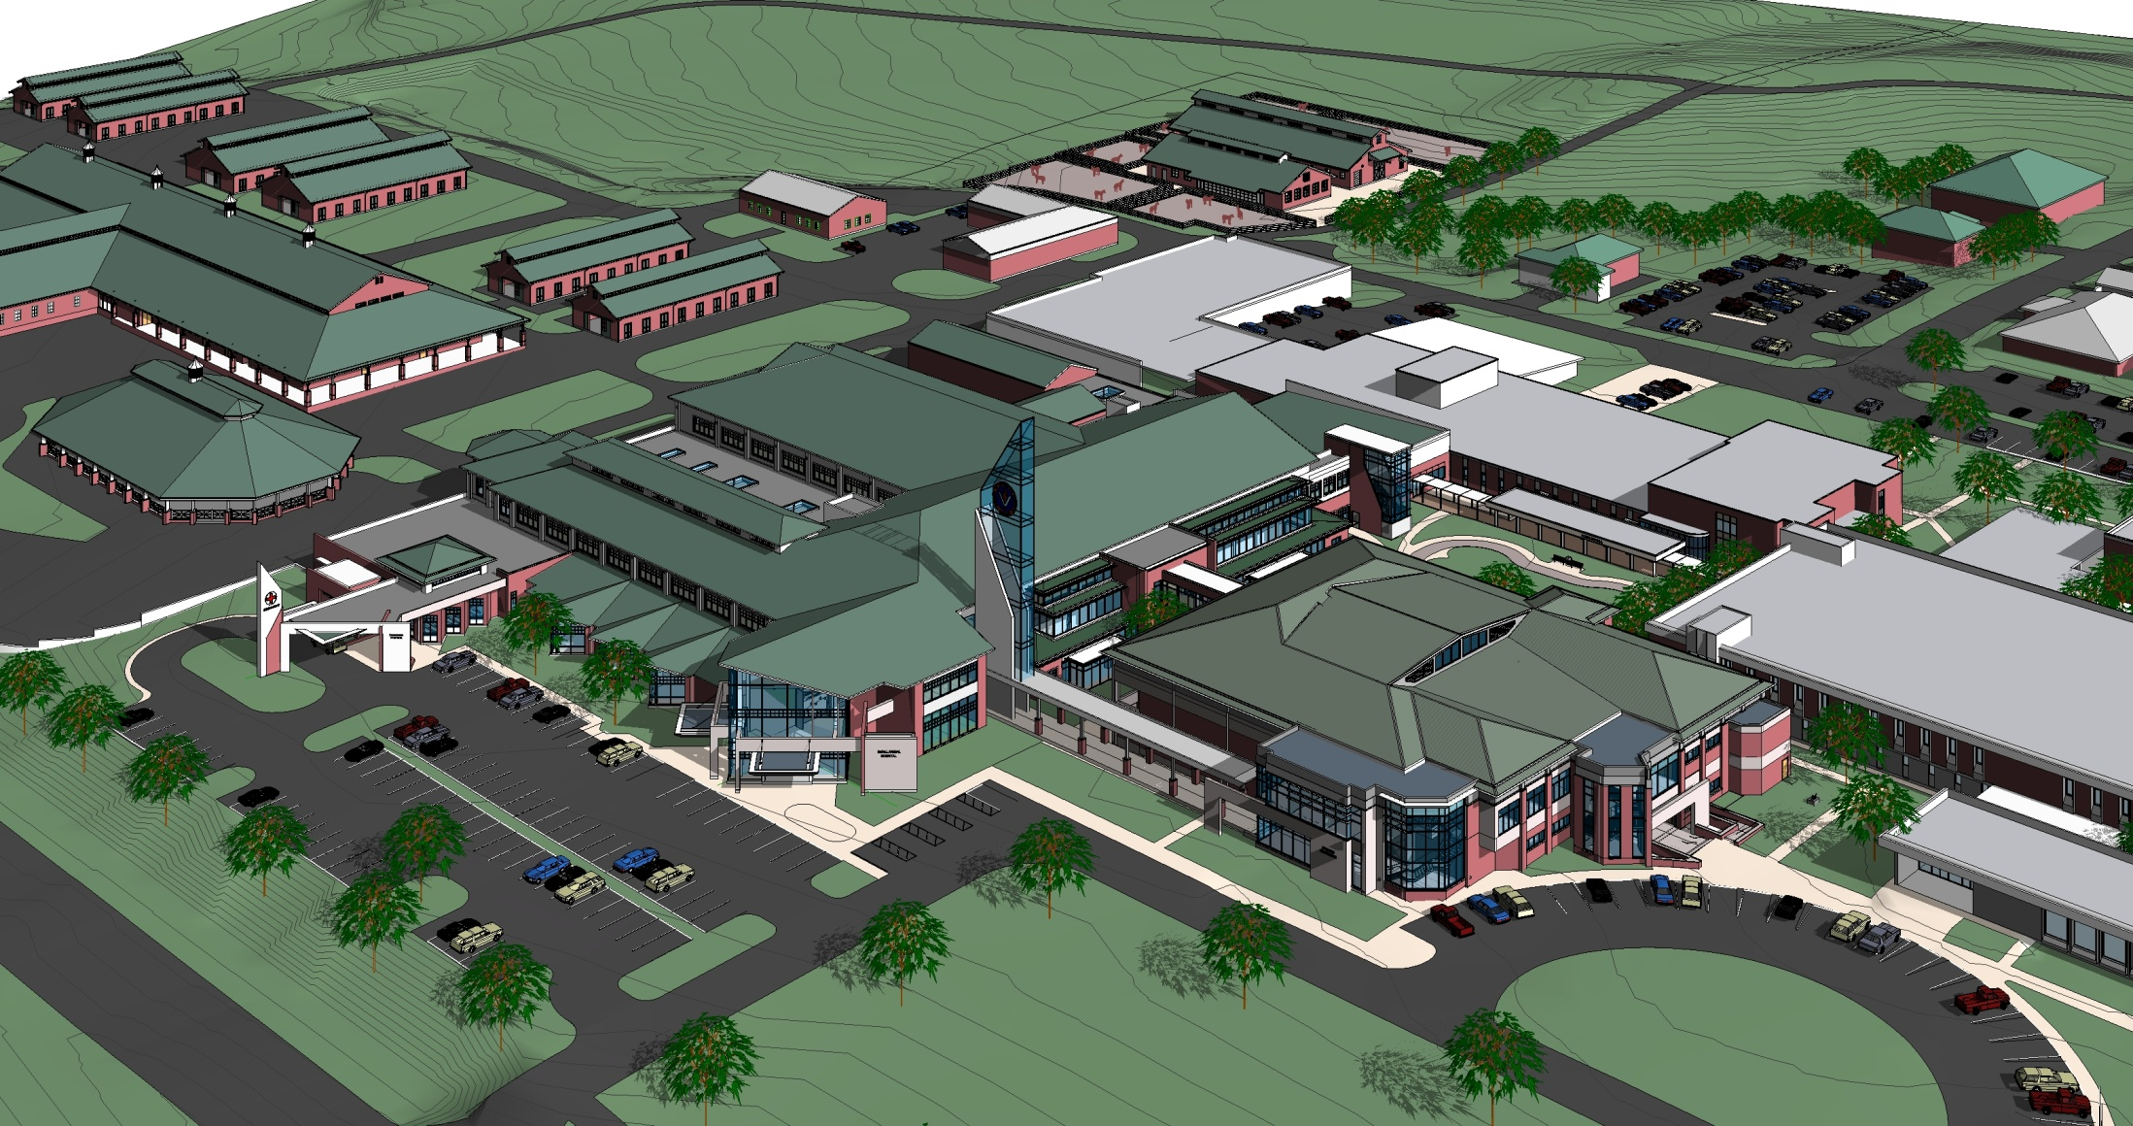
Auburn University CVM Campus

Slide 5
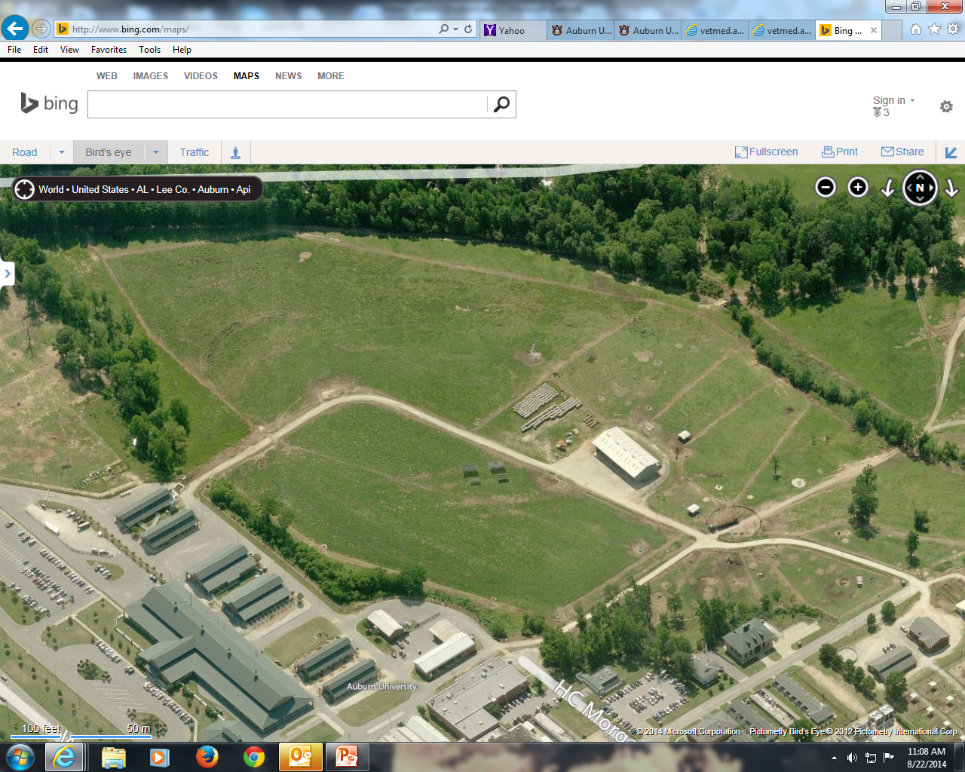
Auburn University CVM Campus
Dairy Barns
Large Animal Isolation
Dairy Cattle Pastures/Facilities
Equine Barns
Food Animal/Beef Barns

Slide 6
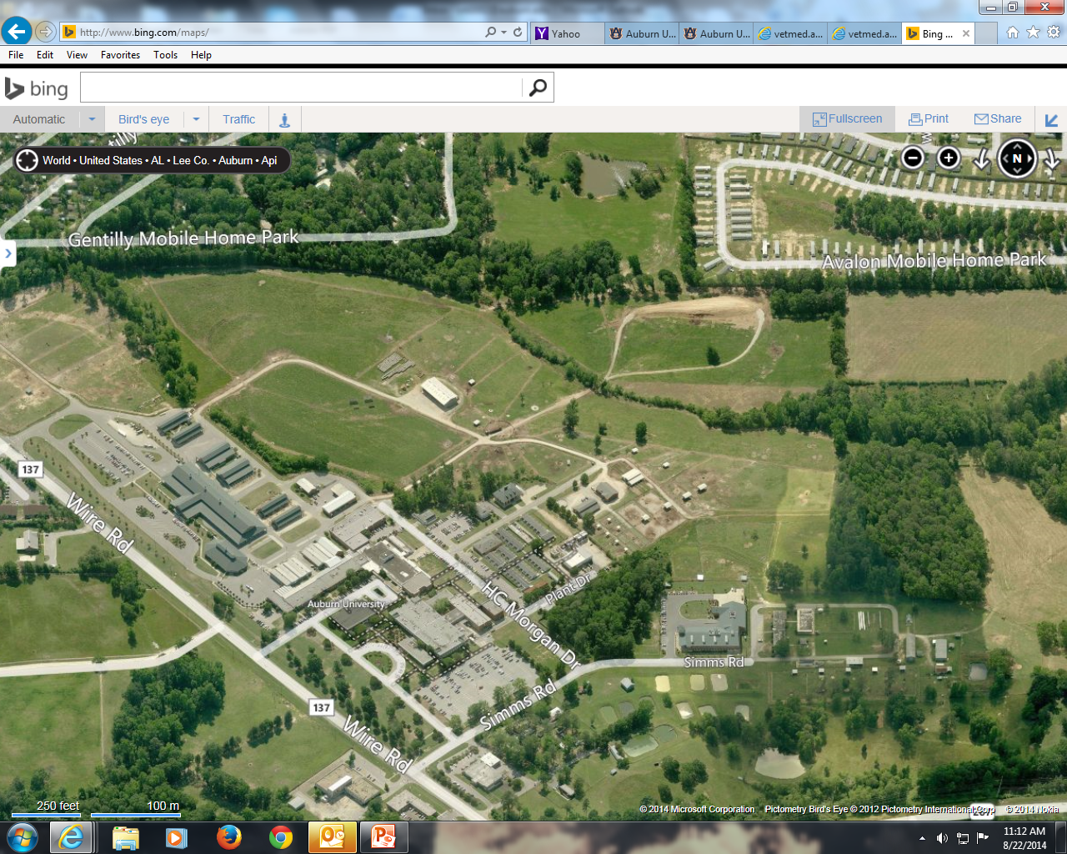
Auburn University CVM Campus
Animal Health
Pastures and Facilities

Slide 7
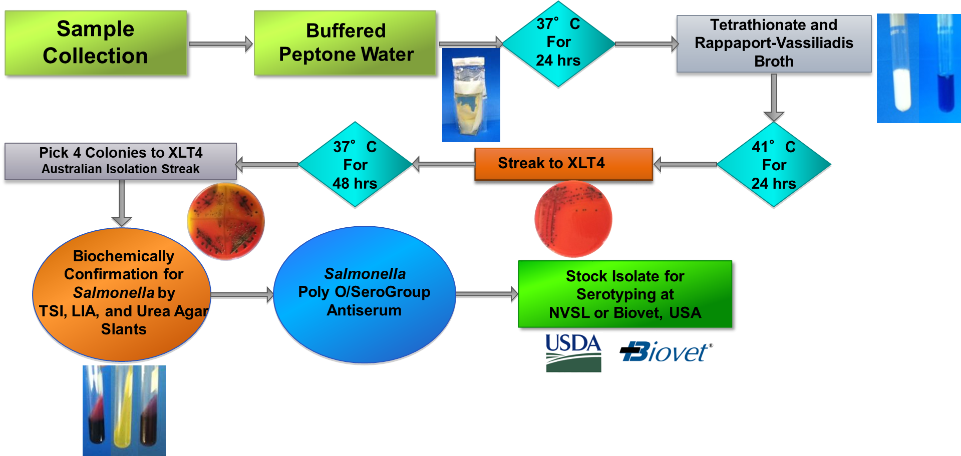
Isolation of Salmonella spp from Environmental Samples
893 total samples collected quarterly from Winter 2014 to Fall 2016
USDA/FSIS Microbiology Laboratory Guidebook
“Isolation and Identification of Salmonella from Meat, Poultry, Pasteurized Egg, and Catfish Products and Carcass and Environmental Sponges”

Slide 8


Statistical Analysis
Independent variable (variable)
Season (S), condition (C), sample method (M), region (R), facility (F), and temperature (T)
Dependent variable (response)
Prevalence of Salmonella
Correlation variables will deal along the way.
Remove variables
Principle component
http://www.sas.com/en_us.html
https://www.r-project.org/
Notes:
Fisher's exact test is more accurate than the chi-square test or G–test of independence when the expected numbers are small. I recommend you use Fisher's exact test when the total sample size is less than 1000, and use the chi-square or G–test for larger sample sizes. See the web page on small sample sizes for further discussion of what it means to be "small".
http://www.biostathandbook.com/fishers.html
you'd expect one or two variables to show a significant result purely by chance, even if diet had no real effect on mammographic density. Applying the Bonferroni correction, you'd divide P=0.05 by the number of tests (25) to get the Bonferroni critical value, so a test would have to have P<0.002 to be significant. Under that criterion, only the test for total calories is significant.

Slide 9
Statistical Analysis
Logistic Regression
Logistic Regression treating Region as random variables, then predict.
Using pairwise comparison to compare the effect within each categorical levels.
Random Forest
Using random forest method to find out the most important parameter and predict.
MCMC
Using MCMC method to get the posteriors parameter for the model, then predict.
http://www.sas.com/en_us.html
https://www.r-project.org/
Notes:
Fisher's exact test is more accurate than the chi-square test or G–test of independence when the expected numbers are small. I recommend you use Fisher's exact test when the total sample size is less than 1000, and use the chi-square or G–test for larger sample sizes. See the web page on small sample sizes for further discussion of what it means to be "small".
http://www.biostathandbook.com/fishers.html
you'd expect one or two variables to show a significant result purely by chance, even if diet had no real effect on mammographic density. Applying the Bonferroni correction, you'd divide P=0.05 by the number of tests (25) to get the Bonferroni critical value, so a test would have to have P<0.002 to be significant. Under that criterion, only the test for total calories is significant.

Slide 10
Logistic Regresssion with Random Effects

Slide 11
Logistic Regresssion with Random Effects
Multiple Comparisons of Means: Tukey Contrasts
Rankings of Variables
Season | Species | Weather Condition | Sample Type
Summer | Bovine | Dry | Water
Spring | Equine | Rain | Drain
Winter | Wildlife |  | Fecal
Fall | Domestic Large Animal |  | Surface
 |  |  | Feed/Hay
 | Group
Species
Bovine | A
Equine | A | B
Wildlife |  | B
Domestic Large Animals |  | B
Season
Summer | A
Spring | A | B
Winter | A | B
Fall |  | B
Sample Type
Water | A
Drain | A
Fecal | A | B
Surface |  | B
Feed/Hay |  |  | C
Accuracy | Sensitivity | Specificity
0.8023 | 0.6747 | 0.9247

Slide 12
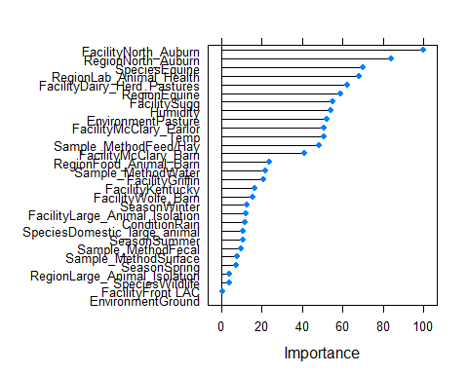
Random Forest
Accuracy | Sensitivity | Specificity
0.8192 | 0.8429 | 0.8037

Slide 13
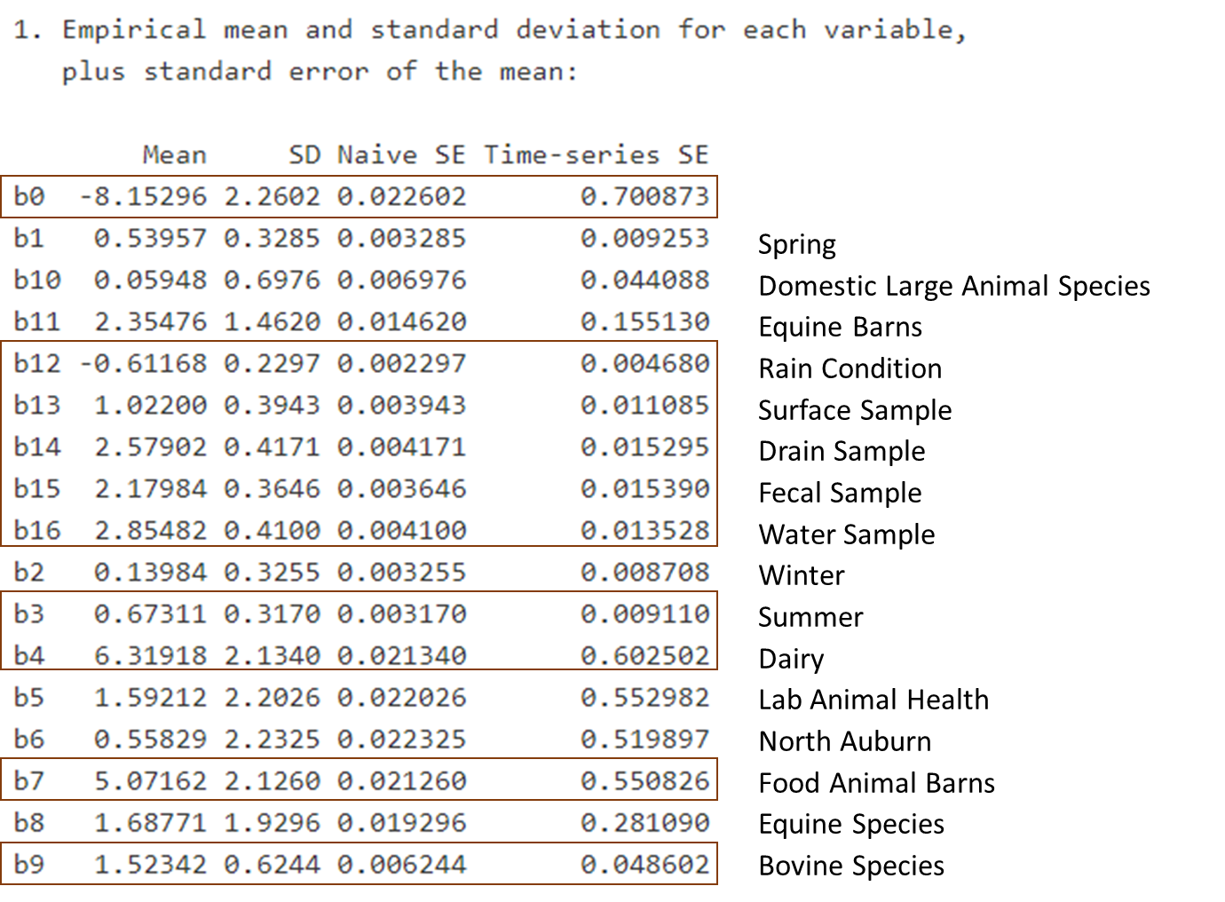
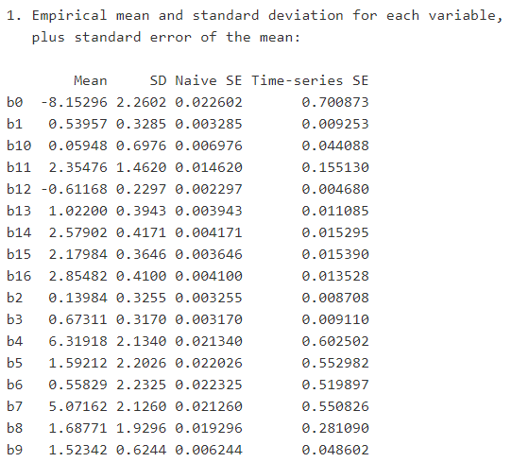
MCMC

Slide 14
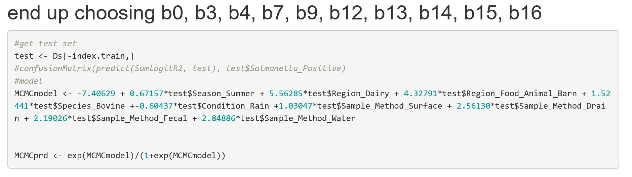
MCMC – Test the Model
Accuracy | Sensitivity | Specificity
0.7910 | 0.6585 | 0.9053

Slide 15
Accuracy – Sensitivity – Specificity
Model Type | Accuracy | Sensitivity | Specificity
Logistic Regression | 0.8023 | 0.6747 | 0.9247
Random Forest | 0.8192 | 0.8429 | 0.8037
MCMC | 0.7910 | 0.6585 | 0.9053

Slide 16
Based on Random Forest
Above Variable Importance > 50
For Predicting Presence of Salmonella
Dairy Herd Pastures
Humidity
Pastures
McClary Parlor
Temperature
McClary Barn

Slide 17

Questions?

Slide 18
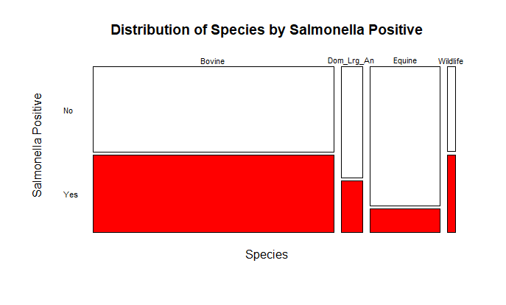

Slide 19
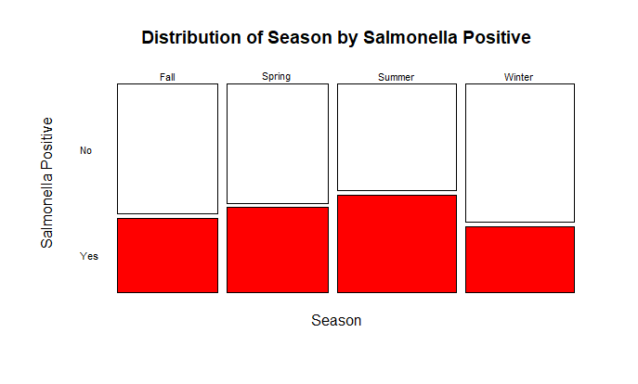

Slide 20
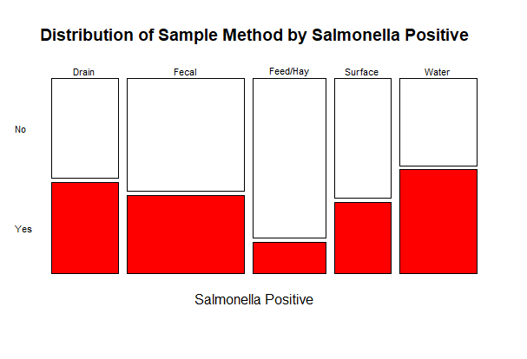

Slide 21
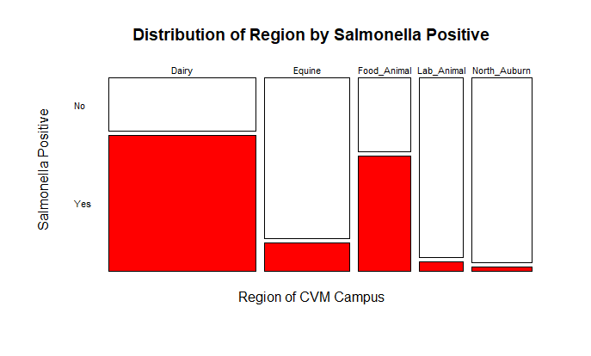

Slide 22
MCMC
Spring
Domestic Large Animal Species
Equine Barns
Rain Condition
Surface Sample
Drain Sample
Fecal Sample
Water Sample
Winter
Summer
Dairy
Lab Animal Health
North Auburn
Food Animal Barns
Equine Species
Bovine Species

Slide 23
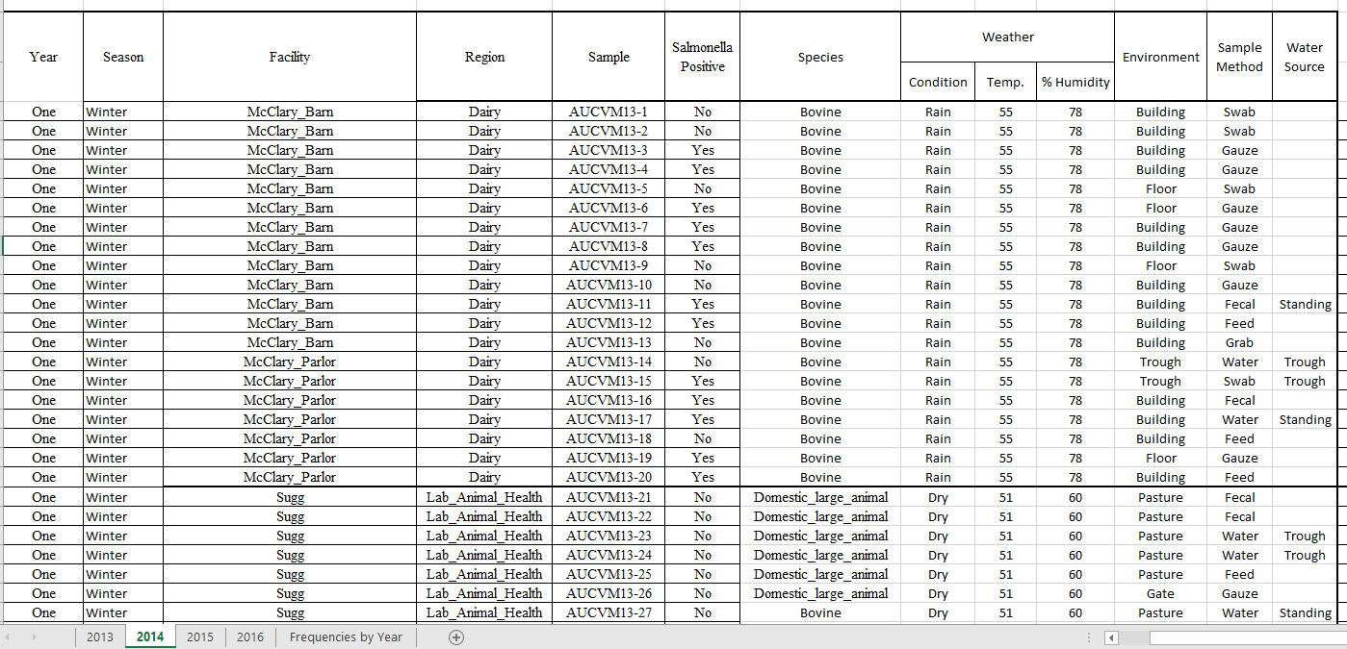
Dataset Example

Slide 24
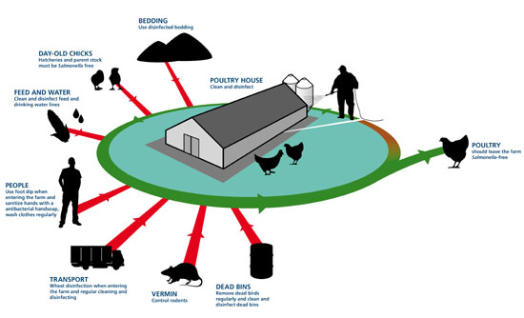
Important Sources of Infection on Poultry Farms
http://www.thepoultrysite.com/articles/contents/11-11-25CIDLines1.jpg

Slide 25
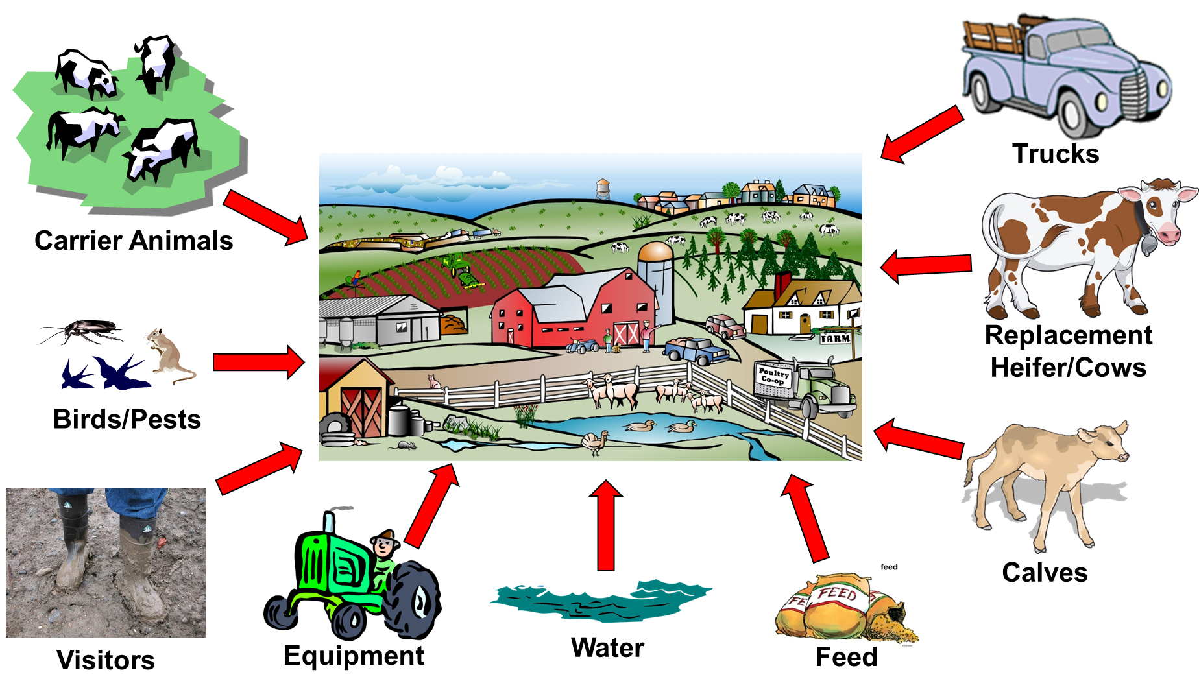
Important Sources of Infection on Cattle Farms

Slide 26


Veterinary Teaching Hospital Outbreaks
Michigan State University – 1996
Salmonella enterica Serovar Typhimurium
28 Horses (44% fatality rate)
Hospital closure – 1 month
12% of Environmental Samples PCR Positive
Purdue University – 1999
Salmonella enterica Serovar Typhimurium
33 Nosocomial cases (42% fatality rate)
1.1% of Environmental Samples Culture Positive
https:///www.pinterest.com/pin/19703317090077447
https://vet.purdue.edu/
Schott, H. C., et al. 2001. An outbreak of salmonellosis among horses at a veterinary teaching hospital. J. Am. Vet. Med. Assoc. 218:1152–1159, 1100.
Ward MP, et al. 2005. Investigation and control of an outbreak of salmonellosis caused by multidrug-resistant Salmonella typhimurium in a population of hospitalized horses 107:233–240.

Slide 27


Veterinary Teaching Hospital Outbreaks
University of Pennsylvania – 2003
Salmonella enterica Serovar Newport MDR-AmpC
61 Animals (36.1% Fatality Rate)
30% Environmental Samples Culture Positive
Indicated widespread environmental contamination
Confirmation from a site visit by biosecurity experts
Cornell University – 2006
Salmonella enterica Serovar Oranienburg
28 Patients – 70% Nosocomial Infections
0.5% Environmental Samples Culture Positive
http://www.vet.upenn.edu/
https://www.facebook.com/CornellVet
Schaer BLD, et al. 2010. Outbreak of Salmonellosis Caused by Salmonella enterica Serovar Newport MDR-AmpC in a Large Animal Veterinary Teaching Hospital 1138–1146.
Cummings KJ, et al, 2014. Salmonella enterica Serovar Oranienburg Outbreak in a Veterinary Medical Teaching Hospital with Evidence of Nosocomial and On-Farm Transmission. Vector-Borne Zoonotic Dis. 14:496–502.
Notes:
Cornell
28 patients – 70% nosocomial infections; 15% farm transmission from discharged EFAH patients; 4% treated at private referral hospital; 11% unrelated community-acquired infections not linked to EFAH.
Penn
Salmonella Newport multidrug resistant (MDR)-AmpC, which is distinguished by presence of the plasmid-mediated ampC gene (bla_{CMY2}) that encodes resistance to extended-spectrum cephalosporins.
Historical data indicated that the proportion of Salmonella positive in- patients increased from 0% in 1998 to 3.8% between January 1 and May 10, 2004. Inpatients identified as high risk (presenting complaints of colic, diarrhea, or fever) had an even greater increase to 19.8% in 2004.
Routine environmental surveillance (ORIG SURV) results were available from 722 samples collected be- tween January 1998 and March 3, 2004; 24 (3.3%) were positive. There was serogroup information on 18 of the 24 isolates; 10 were serogroup C2, 7 serogroup B, and 1 was serogroup D. Ten (41.7%) of the positive samples were recovered after admission of the index case on July 1, 2003 (7 were serogroup C2, 3 were serogroup B).
Environmental surveillance by the ORIG SURV technique increased on March 10, 2004 in areas of the hospital in which salmonellosis had occurred (171 samples collected). From March 10, 2004 until closure, 15 (8.8%) samples collected from the ICU/NICU area and orthopedic barn were positive.
When a more sensitive, modified ISO culture method (a component of MOD SURV) was implemented at the end of April, 8/25 (32%) environmental samples were positive. At this time, the ICU/NICU and orthopedic barn were closed to new admissions.
However, MOD SURV results from the 120 samples collected (April 27, 2004) in these areas indicated widespread environmental contamination; 36/120 (30%) were positive for Salmonella serogroup C2. Human traffic and animal areas were affected; all isolates were later confirmed as S. Newport MDR-AmpC. Confirmation of extensive and repeated contamination, combined with findings from a site visit by biosecurity experts (Drs Paul Morley and David Van Metre, May 5–10, 2004) resulted in full hospital closure on May 10, 2004. After closure, 222 samples were collected from across the extended campus (650 acres outside of themain hospital); only 3were positive for Salmonella, and none matched the outbreak strain. Based on these results, restricted (Widener Hospital) and nonrestricted (extended campus) zones were identified and traffic control measures were implemented.

Slide 28


Environmental Surveillance Studies
Colorado State University – 2002
S. Newport, S. Typhimurium, S. Agona, S. Havana, untypable
11.9% Positive Cultured Environmental Samples
The Ohio State University – 2007
5.9% Environmental & Animal Samples Culture Positive
9% from Food Animal Section
2.5% from Equine Section
S. Paratyphi B, S. Kentucky, S. Cerro, S. Montevideo
https://www.facebook.com/CSUVetMedBioSci/
https://vet.osu.edu/
Burgess, B. a, et al. 2004. Environmental surveillance for Salmonella enterica in a veterinary teaching hospital. J. Am. Vet. Med. Assoc. 225:1344–1348.
Pandya M, Wittum T, Tadesse DA, Gebreyes W, Hoet A. 2009. Environmental Salmonella Surveillance in The Ohio State University Veterinary Teaching Hospital. Vector-Borne Zoonotic Dis 9:649–654.
Notes:
Colorado State University James L. Voss Veterinary Teaching Hospital (JLVVTH) and Veterinary Diagnostic Laboratory (VDL) Surveillance Study – 2002
The Ohio State University Veterinary Teaching Hospital Surveillance Study – 2007
Ohio State
S. Paratyphi B var. L-tartate (n=3)
S. Kentucky (n=5)
S. Cerro (n=7)
S. Montevideo (n=1)
5.9% cultured environmental and animal samples tested positive for Salmonella
9% of the samples from the food animal section tested positive for Salmonella
2.5% of the samples from the equine section tested positive for Salmonella
the floor drain surfaces were the most common site for Salmonella recovery at 7.3%
the floor surface samples were similar at 6.7%.
preliminarily sampling on February 20, 2007 & 1-week interval samplings beginning March 19, 2007, through May 21, 2007 – 11 weeks
This study suggests that students and clinicians in the food animal section should be aware of the potential risks. In addition, appropriate biosecurity practices should be in place to prevent nosocomial infections or zoonotic transmission.

Slide 29
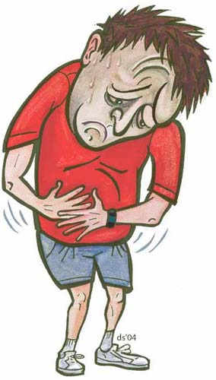


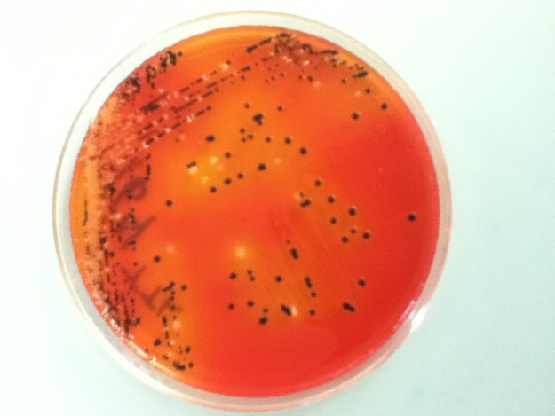

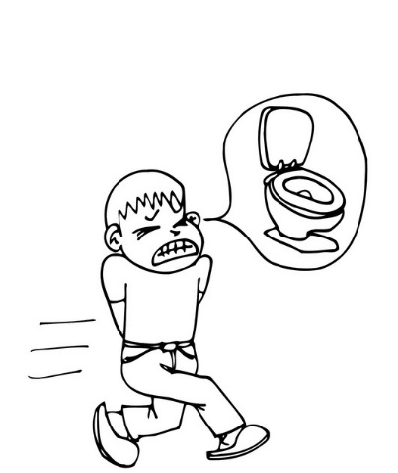

Foodborne Illnesses
http://www.cdc.gov/foodborneburden/2011-foodborne-estimates.html
http://www.cdcfoundation.org/businesspulse/food-safety-infographic
Notes:
Salmonella is most commonly a foodborne pathogen. According to the CDC 1 in 6 Americans will get sick from a foodborned disease this year.

Slide 30

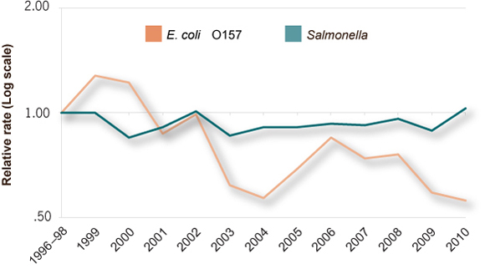

Salmonella Infections
Change in E. coli O157 and Salmonella infection, 1996–2010
http://www.foodsafety.gov/poisoning/causes/bacteriaviruses/salmonella/
http://www.cdc.gov/vitalsigns/foodsafety/
http://www.foodsafety.gov/poisoning/causes/bacteriaviruses/salmonella/
Notes:
Salmonella infection has not declined in 15 years
Salmonella infections alone cost 3.7 billion each year in direct medical costs, productivity, and years of life lost according to the USDA ERS.
Against popular belief, Salmonella is not just a poultry associated pathogen. Salmonella has also be linked to outbreaks in other food sources such as beef, pork, dairy, eggs, and produce.
Reducing Salmonella infection is difficult because

Slide 31
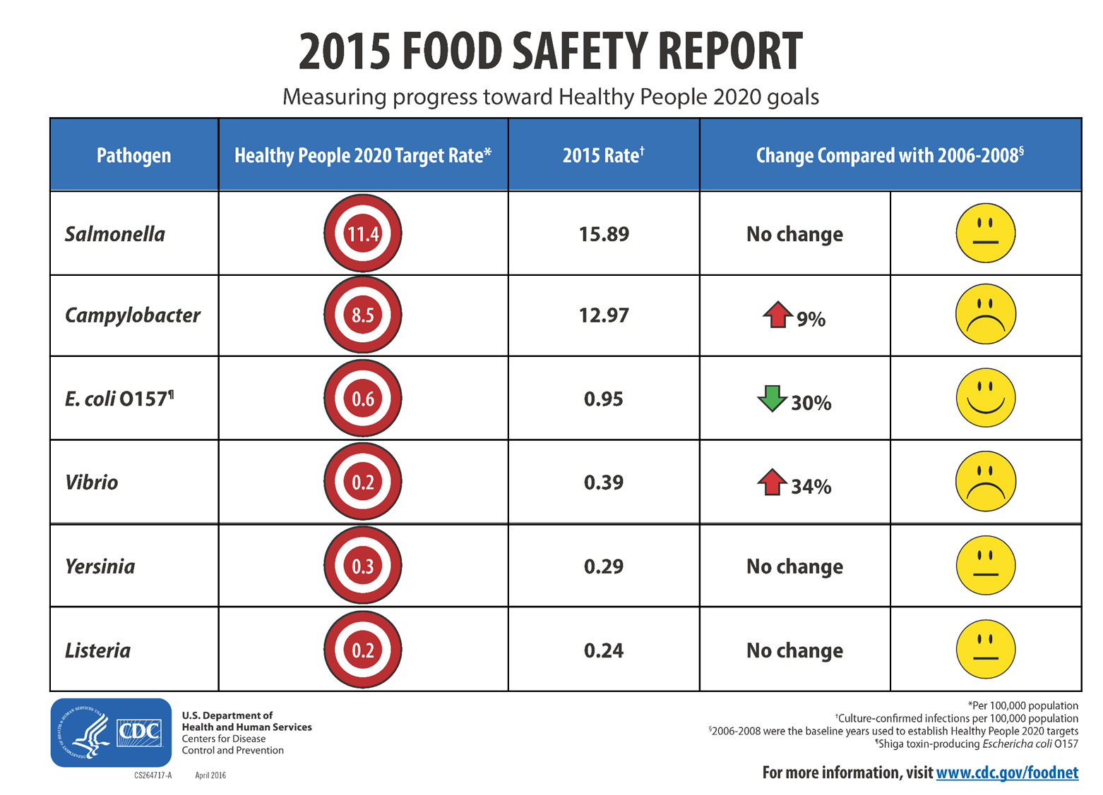
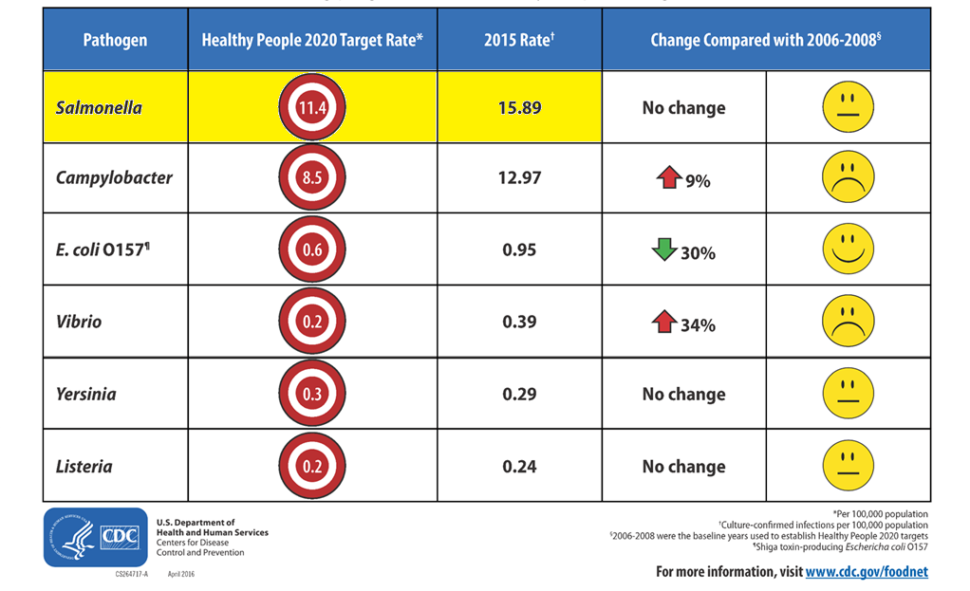
Notes:
2015 – 15.89
2014 – 15.45
2013 – 15.19
2012 – 16.42
2011 – 16.45
National Health Objective for 2020 is 11.4
2010 – 17.6
2009 – 15.19
2008 – 16.20
2007 – 14.92
2006 – 14.81
2005 – 14.55
2004 – 14.7
2003 – 14.5
National Health Objective for 2010 was 6.8
2002 – 16.1
2001 – 15.3
2000 – 14.2
1999 – 14.8
1998 – 12.3
1997 – 13.6
1996 – 14.5
On January 1, 1996, FoodNet began collecting population-based active surveillance data on culture-confirmed cases of seven potentially foodborne diseases (Campylobacter, Escherichia coli O157:H7, Listeria, Salmonella, Shigella, Vibrio, and Yersinia infections) among the 13.2 million residents in five EIP sites
1995 – 15
1994 – 15
1993 – 15
1992 – 14
1991 – 16
1990 – 16
1989 – 17
1988 – 18
1987 – 18
Healthy People Objective for 2000 was 16
1987-1994 Data: Bacterial Meningitis Surveillance System (BMSS), CDC, NCID; Campylobacter Surveillance System (CSS), CDC, NCID; Salmonella Surveillance System, CDC, NCID.
1996-1997 Data: Foodborne Disease Active Surveillance Network (FoodNet), CDC, USDA, FDA
http://www.cdc.gov/nchs/healthy_people/hp2000/reviews/food_safety.htm
http://www.cdc.gov/nchs/products/hp_pubs/highlightshp2000.htm
National Center for Health Statistics.
Healthy People 2010 Final Review.
Hyattsville, MD. 2012.
National Center for Health Statistics. Healthy People 2000 Final Review. Hyattsville, Maryland: Public Health Service. 2001. Library of Congress Catalog Card Number 76–641496

Slide 32

http://www.cdc.gov/foodsafety/outbreaks/investigating-outbreaks/production-chain.html

Slide 33
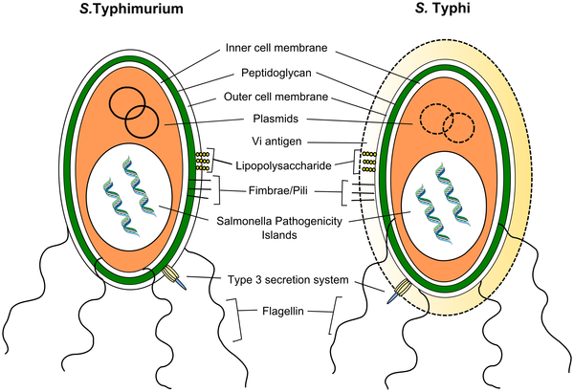

Figure 2. Virulence of S. Typhimurium and S. Typhi.
de Jong HK, Parry CM, van der Poll T, Wiersinga WJ (2012) Host–Pathogen Interaction in Invasive Salmonellosis. PLoS Pathog 8(10): e1002933. doi:10.1371/journal.ppat.1002933
http://journals.plos.org/plospathogens/article?id=info:doi/10.1371/journal.ppat.1002933
Notes:
Figure 2. Virulence of S. Typhimurium and S. Typhi.
S. Typhimurium and S. Typhi possess partly overlapping and a partly distinct repertoire of virulence factors. Both serovars express the type III secretion system, lipopolysaccharide, and other surface polysaccharides, fimbrae, flagellin, and bacterial DNA. The Vi antigen is exclusively expressed by S. Typhi and is able to circumvent the innate immune response by repressing flagellin and LPS expression. SPI, Salmonella pathogenicity islands.

Slide 34
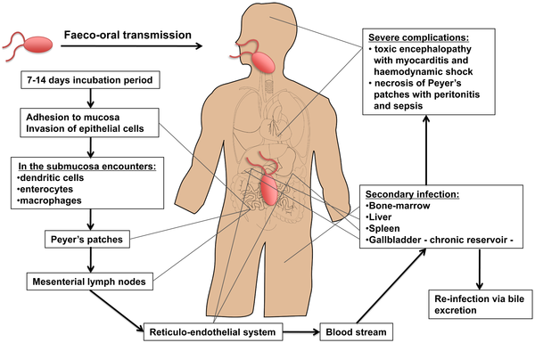
Figure 1. Dissemination of S. Typhi during systemic infection.
de Jong HK, Parry CM, van der Poll T, Wiersinga WJ (2012) Host–Pathogen Interaction in Invasive Salmonellosis. PLoS Pathog 8(10): e1002933. doi:10.1371/journal.ppat.1002933
http://journals.plos.org/plospathogens/article?id=info:doi/10.1371/journal.ppat.1002933
Notes:
Figure 1. Dissemination of S. Typhi during systemic infection.
Typhoid is usually contracted by ingestion of food or water contaminated by fecal or urinary carriers excreting S. Typhi. The incubation period is usually 7 to 14 d. In the small intestine the bacteria adhere to the mucosa and then invade the epithelial cells. The Peyer's patches, which are aggregrated lymphoid nodules of the terminal ileum, play an important role in the transport to the underlying lymphoid tissue. Specialized epithelial cells such as M cells overlying these Peyer's patches are probably the site of internalization of S. Typhi. Once the bacteria have penetrated the mucosal barrier, the invading organism translocates to the intestinal lymphoid follicles and the draining mesenteric lymph nodes, and some pass on to the reticuloendothelial cells of the liver and spleen. During the bacteremic phase, the bacteria are widely disseminated throughout the body. Secondary infection can occur with liver, spleen, bone-marrow, gallbladder, and Peyer's patches as the most preferred sites. The gallbladder is the main reservoir during a chronic infection with S. Typhi and invasion occurs either directly from the blood or by retrograde spread from the bile. Of interest, the ability of Salmonella to form biofilms on gallstones is likely to be a critical factor in establishment of chronic carriage and shedding of S. Typhi [88]. The bacteria that are excreted in the bile can then reinvade the intestinal wall by the mechanism previously described or are excreted by feces. Typical clinical symptoms are fever, malaise, and abdominal discomfort. Clinical features such as a tender abdomen, hepatomegaly, splenomegaly, and a relative bradycardia are common. Rose spots, the classical skin lesions associated with typhoid fever, are relatively uncommon and occur in 5%–30% of cases. The most severe manifestations of typhoid leading to sepsis and death are either necrosis of the Peyer's patches resulting in gut perforation and peritonitis or a toxic encephalopathy associated with myocarditis and haemodynamic shock [8], [89].
http://dx.doi.org/10.1371/journal.ppat.1002933.g001

